Slide 1
IT’S ALL GAMES NOW the convergence of games and social media
Raph Koster
VP Creative Design

Slide 2
Once upon a time…
There was a surreal kingdom inhabited by wondrous creatures.

Slide 3
The magic circle
They lived inside a magic circle: a shimmering barrier put up by powerful magicians.
It was transparent, but hard, like glass.

Slide 4
Outside the magic circle of this kingdom was the wild world - called wild because unlike the kingdom, it was not controlled by rules.

Slide 5
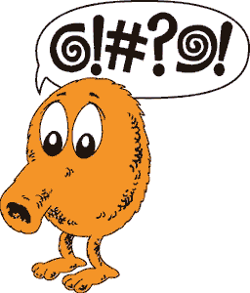
Stuff that happened in the wild world didn’t count for much inside. The magic circle the sorcerers had put in made it that way.
It was really hard for anything inside the magic circle to get out.

Slide 6
A fascinating thing about the critters was that they were made of math.
Oh, they might have looked like they were made of flesh and bone, but really, they weren’t.

Slide 7
Only a few people came into the magic circle and played with these amazing creatures.
And they often learned much, and took that learning back with them to the wild world.

Slide 8
But the wild world grew more civilized with time.
And eventually, its borders came right up to the very edge of the magic circle, and something frightening happened.

Slide 9
The circle began to leak.

Slide 10
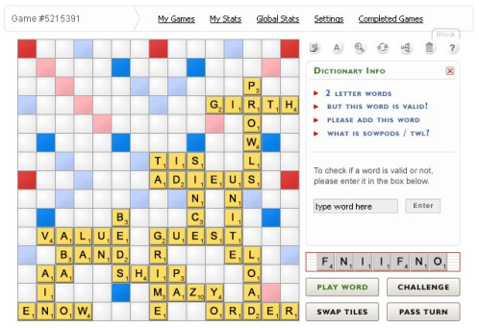
Scrabulous

Slide 11
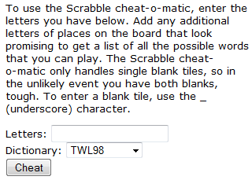
Cheat-O-Matic

Slide 12
“Charlton said that since the debut of Facebook Scrabulous in June, the Cheat-O-Matic has seen its traffic go from about 4,000 page views a day to more than 120,000. Charlton points out that the site gets only about 17,000 unique visitors -- only a small fraction of the number of Scrabulous' 400,000 active players. But that also means that each visitor is running the calculator an average of seven times a day.”
L.A. Times, Jan 6, 2008

Slide 13
Scrabulous
“After inputting the board and my letters –
I-BLANK-A-T-U-E-D
– the program spit back the ideal move: DEUTZIA for 73 points. Nevermind I had no idea what a deutzia was.”

Slide 14
Strategy Guides
“There is a very significant difference between reading a strategy guide and buying money or characters. The former educates you on how to be a better player, sending you out into the virtual wilds to do the work yourself. The latter takes the game out of your hands and supplies you with the end result of the labours.”
- Ten Ton Hammer, Dec 29, 2007

Slide 15
Strategy Guides
“Getting information is not introducing an artificial mechanic to the game. It does not give one player an advantage over the other because all players have access to this information from various free and paid sources. The same can be said about RMT…different players can afford differing amounts of gold, and some can’t afford any at all. Having that information available to all players is key to this, because that may not have been the case back in the days of the MUD.”
- The Common Sense Gamer, Dec 27th, 2007

Slide 16
MUD etiquette
(Sorry guys, but yes, back in the mud days, you could be banned for publicly disclosing the steps to a quest.)

Slide 17
“It was probably a lot more fun,” he said, “when I knew that I was the only person on the Internet that had the potential to use it as a cheat.”
- the anonymous creator of ScrabbleWordFinder.com

Slide 18
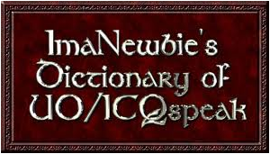
Global chat

Slide 19
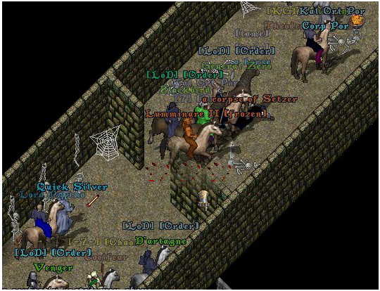
Guilds
Original Ultima Online did not have guild support.
Players actually created new characters just to stick their guild affiliations in their names.
Quitting the guild meant permadeath!
So I had to code a guild system. Broke the server.

Slide 20
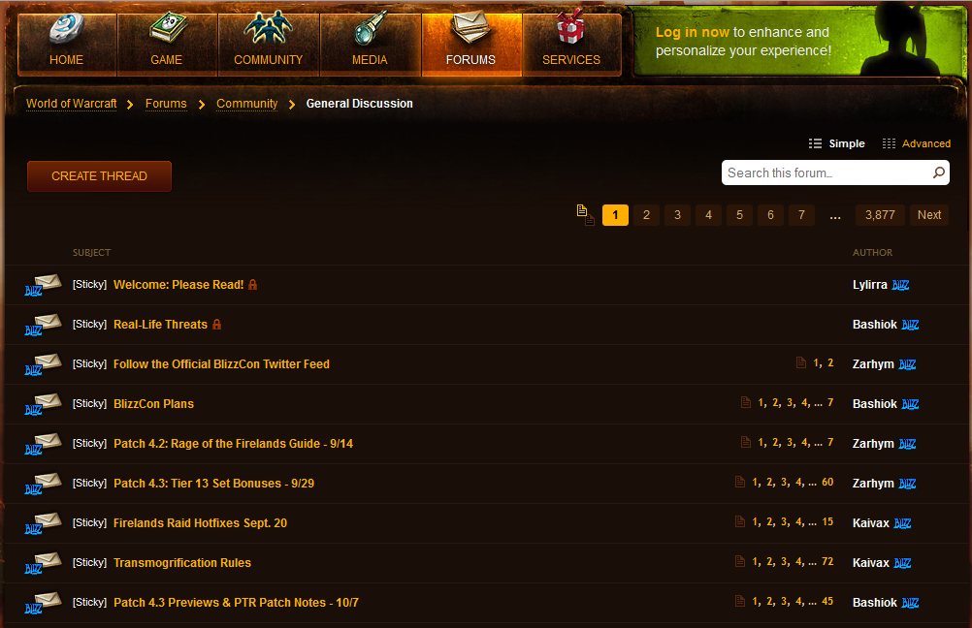
Forums

Slide 21
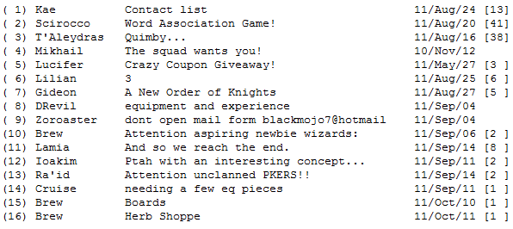

Slide 22
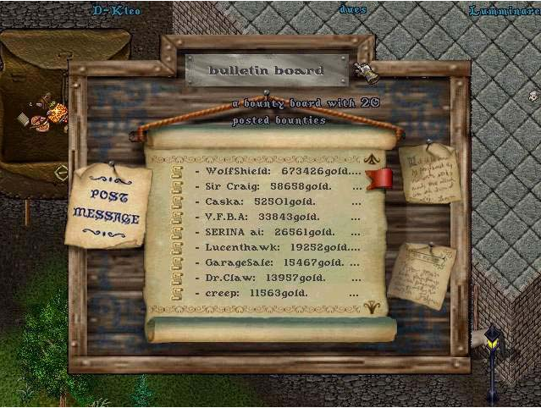
Ultima Online in-game message board

Slide 23
Back to our story…
The wild world geographers came from far and wide to measure the circle, and to test its permeability.

Slide 24
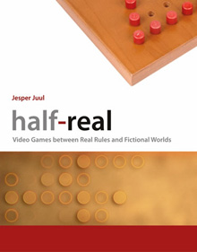
Some of them were merely curious as to how exactly things worked inside.

Slide 25
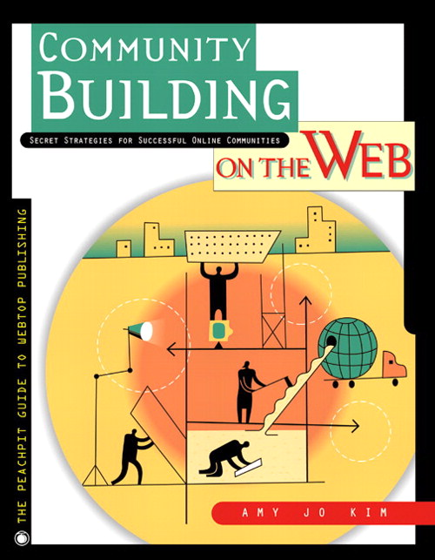
Some of them gently worked to show the citizens of the magic land the many wonderful things that could come from working with the wild world.

Slide 26
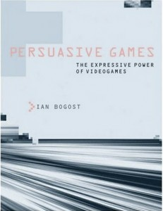
Once upon a cow…
Some of them cast mighty, impenetrable spells against it to try to force it open! They got sucked into it instead, and eventually raptured.

Slide 27
Some of the wizards from inside the magic circle tried to push the circle outwards and make it bigger, out of idealism; to change the wild world into a place where rules once again applied for the good of everyone.

Slide 28
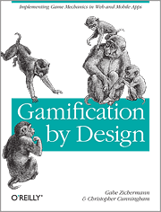
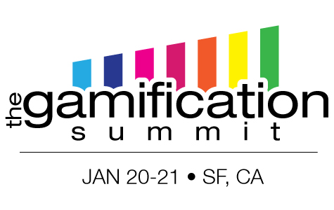
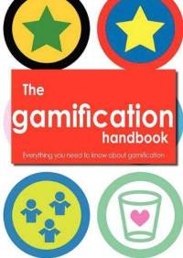
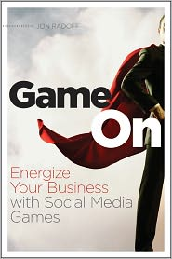
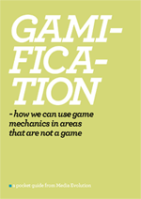
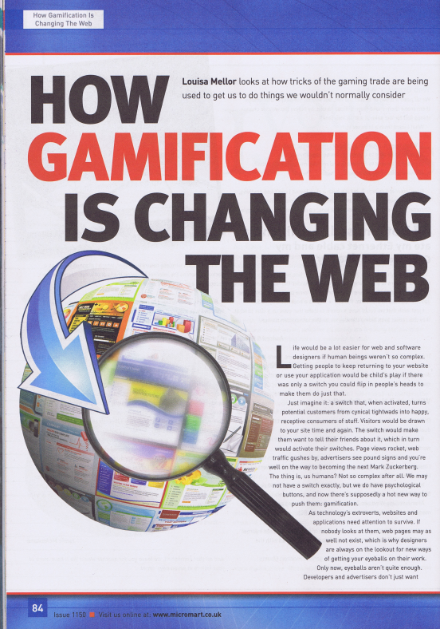
Others had…. other agendas…

Slide 29
The science worked
We now understand far more about how games work than we did ten years ago.

Slide 30
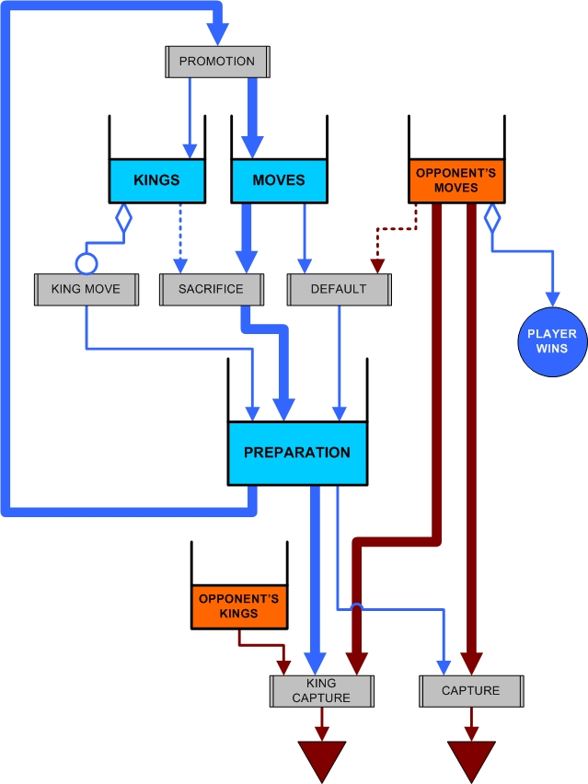
A Game Grammar
by Stéphane Bura
http://www.stephanebura.com/diagrams/

Slide 31
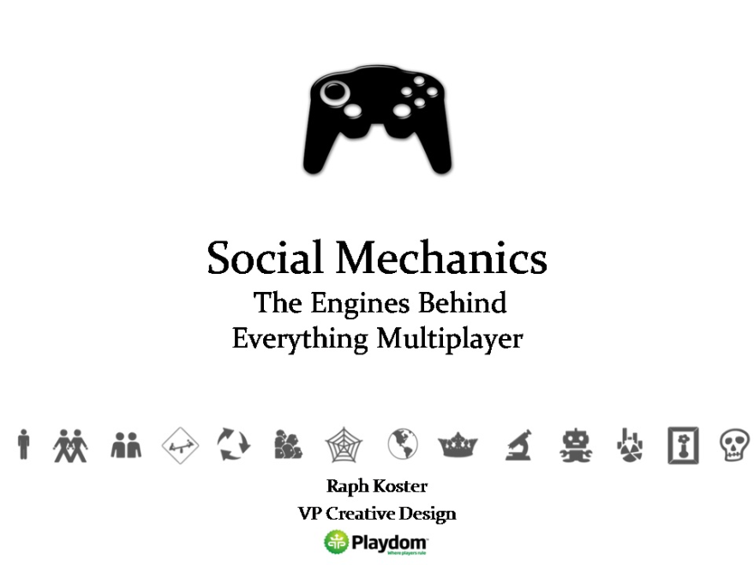
We also co-opted other sciences
Identity
Signaling
Roles
Profiles
Reputation
Credentials
Clusters
Ad hoc groups
Tribal identity
Trade
Power laws
Societies
Weak ties
Trust
Governance
History
Communication channels
Synchronous
Asynchronous

Slide 32
Individuals
Identity formation
Particularly notable during adolescent years, as identity exploration results in association with memetic tribes.
Signaling theory
Premise: that we consciously and unconsciously select to display our psychological traits publicly to attract mates, tribes, and determine relative standing.
Roles
Provides each individual a reason to specialize, and thereby webs the individual more tightly into the community as a whole.

Slide 33
Clusters
Individuals tend to web together into social networks that are “lumpy.”
Plenty of other material out there on this topic.
Clusters exhibit homogeneity
Of genetics (family/tribe networks), of ideas
Clusters tend to be densely webbed and have “strong man” leaders
Hierarchy and law emerges with scale.

Slide 34
Economics
Organization is a means of caloric maximization.
A method of extracting greater value from limited resources.
In the end, this is what drives community formation.
Gini Coefficient structures emerge.
Wealth distribution is always inequal; excessive inequality leads to social unrest.
Power laws manifest in all sorts of ways.

Slide 35
Society
Weak ties manifest as important as the network achieves scale.
Classic example is how you obtain jobs.
Weak ties serve to bridge clusters.
Social class instead of hierarchy develops.
Trust and faith and social contract.
Law theoretically works to keep these in balance.
History begins to be needed.

Slide 36
Contextual vs non-contextual
Contextual methods are ones that are explained within the game fiction.
Non-contextual ones are bolted on, with no justification provided.
Many of these are within the game, despite being non-contextual.
Often supported via the game ecology, rather than by the game proper; for example, forums on the web.

Slide 37
Synchronous vs asynchronous
Synchronous methods occur in near-realtime.
You have to be there to get the message.
Messages are not persistent.
Asynchronous methods are post-and-retrieve.
Messages are persisted.
Recipients do not need to be present at the time.

Slide 38
Spatial broadcast
Synchronous, usually contextual
“Say”: limited range broadcast to multiple recipients
“Talk”: like say, but one recipient called out publicly as the intended recipient
“Whisper”: like talk, but message is garbled for any but the recipient, unless skills or proximity override
Moods, to increase the bandwidth of communication and puppeteering capability.

Slide 39
Peer to peer
Instant messages sent to single recipients.
Generally synchronous
Almost always non-contextual
Some games explain it with psionics or communicators
“Tell” is the classic command
May add AFK buffers, answering machines, etc, making it asynch
ICQ/IM is a more complex variant that becomes asynch

Slide 40
Multichannel broadcast
Synchronous system.
Subscribe to channels to receive text, rather than using distance
Almost always non-contextual
Static chat channels are the standard implementation
Can also support dynamic conferencing

Slide 41
Asynch peer to peer
Messages sent to a mailbox to be retrieved later.
Embedded mail systems used to be common in virtual worlds but have faded away.
AFK systems in instant messaging systems accomplish the same thing
Almost always non-contextual

Slide 42
Asynch broadcast
Persistent messages broadcast to multiple people
Most text muds support embedded bulletin board systems
But commercial games have tended not to.
May have “channels” like chat by using different boards
Boards often tied to locations (thus contextual) but not always.

Slide 43
A grid of comm channels
 | 1 to 1 | 1 to many | Many to many
Synchronous | Tell IM | Shout | Chat IRC
Asynchronous | Email Messages | Wall Twitter | Forums

Slide 44
Synchronous grouping
Players working as a team to accomplish a goal.
In sports, competitive PvP games, and MMOs this is a standard mechanic.
Typically accompanied by communication channels.

Slide 45
Persistent social structures
Creating persistent associations of users that the game is aware of.
In the absence of game support, players will create these anyway using external facilities.
Ultima Online
Quake

Slide 46
Avatars, characters and profiles
Avatar: best regarded as the appearance presented by a given player in the environment.
Character: originated as the statistical description of a given player’s in-world proxy.
Profile: typically refers to the non-statistical elements.

Slide 47
Avatar Attributes
Tangible attributes
Things that affect the physics of the game world in some manner
What we tend to think of as “stats”
This is how the server relates to an avatar.
Intangible attributes
Leadership, charisma, prejudices, eloquence.
This is how other players relate to the avatar.

Slide 48
Components of profiles
Name
Description
Tangible attributes (maybe how healthy they are)
A list of equipment
Some degree of history (levels achieved)
Perhaps a reputation (criminal flag, etc)

Slide 49
Classes as modes of expression
Classes, roles, and many other intangible elements are quantified by selecting a prepackaged appearance and competency.
This allows for users to easily do crude self-sorting into affinity groups.
It also allows for instant interdependence dynamics.
Essentially, these choices are modes of expression for users, transforming the intangible into the tangible.

Slide 50
Pseudonymity
Going back to early ARPANET, pseudonyms were common.
Games leveraged both magic circle and the roleplaying tradition to embrace pseudonymity as well.
Shown to reduce grief behavior over anonymity, albeit not to the degree that known identity does.
Many classic cases where unmasking caused greater grief.

Slide 51
Badge systems vs achievements
Also trying to quantify intangibles.
Badges were born originally as a history of past significant achievements.
Achievements instead become a meta-game, but still provide signaling value.
Think of analogy to real world educational degrees
More useful for indicating character than skill.

Slide 52
Reputation systems
A means of quantifying player opinions of other players based on atomic interactions.
They spiral out of control when you use negative ratings
They gain credibility over time when you use positive ones
But punish those with little history in the system

Slide 53
Large scale structures
Hierarchy
Formalized authority roles for in-game social structures.
Sense of history
Extremely common to see passionate users creating giant history sites about their tribe or guild
Migration to the real
The true measure of success in community building

Slide 54
Governance
Hmm, governance didn’t migrate out.

Slide 55
98%
of Americans use social media today.
510,000
comments per minute.
293,000
status updates per minute.
136,000
photos uploaded per minute.
694,000
“shared items” (as opposed to authored) per minute.
All stats from Facebook.

Slide 56
Game version | Social media version
Say | Wall
Public chat | Twitter
Tell | IM
Board | Forum
Mail | Message
In-game item | Gifting
Guild | Group
Intangible reputation | Klout
Badges | Achievements
Trade | RMT
Content creation | Content curation
Assistance | Quora
Classes and levels | LinkedIn
Austion houses | eBay
Gold coins | Facebook credits
Stats | Quantified self
Friends list | Circles

Slide 57
What games do to our brains
They teach us to quantify.
They teach us to be reductionist.
They teach us that everything can be solved – indeed, there is a “right answer.”

Slide 58
The tale resumes its onward march…
It was then that the mages who lived inside the magic circle realized that they had handed the keys to the kingdom to those from outside.

Slide 59
The circle did indeed begin to grow, but as it grew, the shimmering blue light also grew dimmer.

Slide 60
Some called it the World-swallowing.

Slide 61
But no one was sure which world was the eater, and which world the consumed.

Slide 62
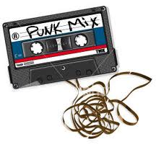
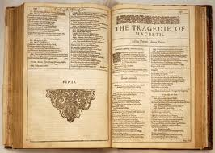

Slide 63
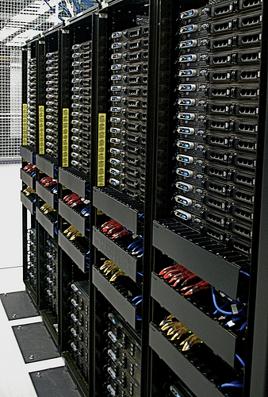
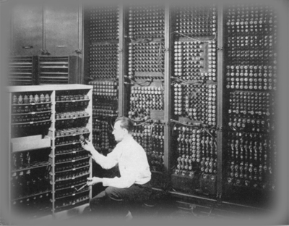
The Cloud

Slide 64
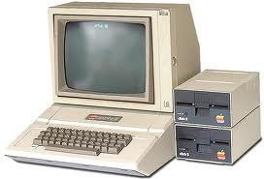
The local

Slide 65
The pendulum

Slide 66
It means someone else has their finger on the power
button.

Slide 67
Typical console system features
Ever since the crash of ‘83
1st parties control the distribution volume
1st parties maintain rigid TRC requirements
1st parties play “most favored nation” with developers
1st parties control the shelf/marketing
Particularly via “house organ” style channels
1st parties demand a cut of the revenue

Slide 68
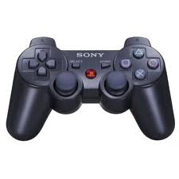
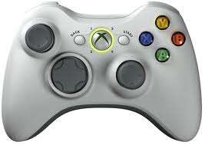

Slide 69
A brief short-term forecast
Entry costs will continue to rise because
Platforms like high quality
Platforms derive revenue from those costs
Dev costs will rise because
Greater revenue comes from the passionate aka hardcore
Who demand greater sophistication/tech over time
The middle will hollow out
Big players will spend against these costs
Low end just won’t make money
Genrefication will ensue
To minimize risk
Welcome back to 1997! In fact, I do believe

Slide 70
A sad moment.
Then a tragic thing happened.
One of the mightiest of the wild world wizards died.

Slide 71
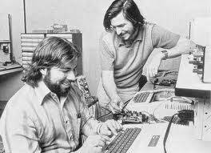
He was someone born with one foot over the magic circle.

Slide 72
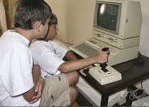
And so much of his early work was about the power of play.

Slide 73
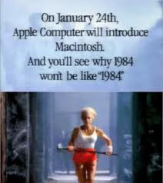
He challenged priesthoods and he gave the power of expressive play to everyone.

Slide 74
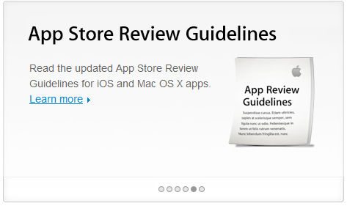
People were empowered… but as his work progressed, we were paradoxically disempowered too.
Soon the priesthood came back.

Slide 75
We were both more, and less, powerful.

Slide 77
What Design Is
To a large degree, curbing people is implicit in what we call “design” – we shape affordances.
Good affordances guide people towards acting in certain ways.
Design is mind control.

Slide 78
Good design, and game design
Game design is only part mind control, just like good art is only part mind control.
It’s about putting people into a framework and letting them find and discover and play and experiment and shape their reality.
Then they leave the game – the art – and have these new tools to work with.

Slide 79
Bad designer, no cookie!
Bad art, propaganda, and the like, is full mind control.
It’s where you are presented with an illusion of choice, but they all go to the same place.
You leave with the mistaken impression that it is the right, the only possible, choice.

Slide 80
There is real power in quantified thought

Slide 81
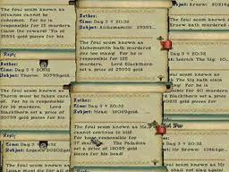
But there are real risks too

Slide 82
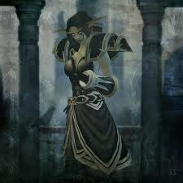
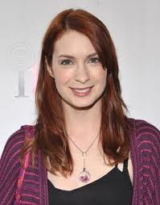
From avatars to real people

Slide 83
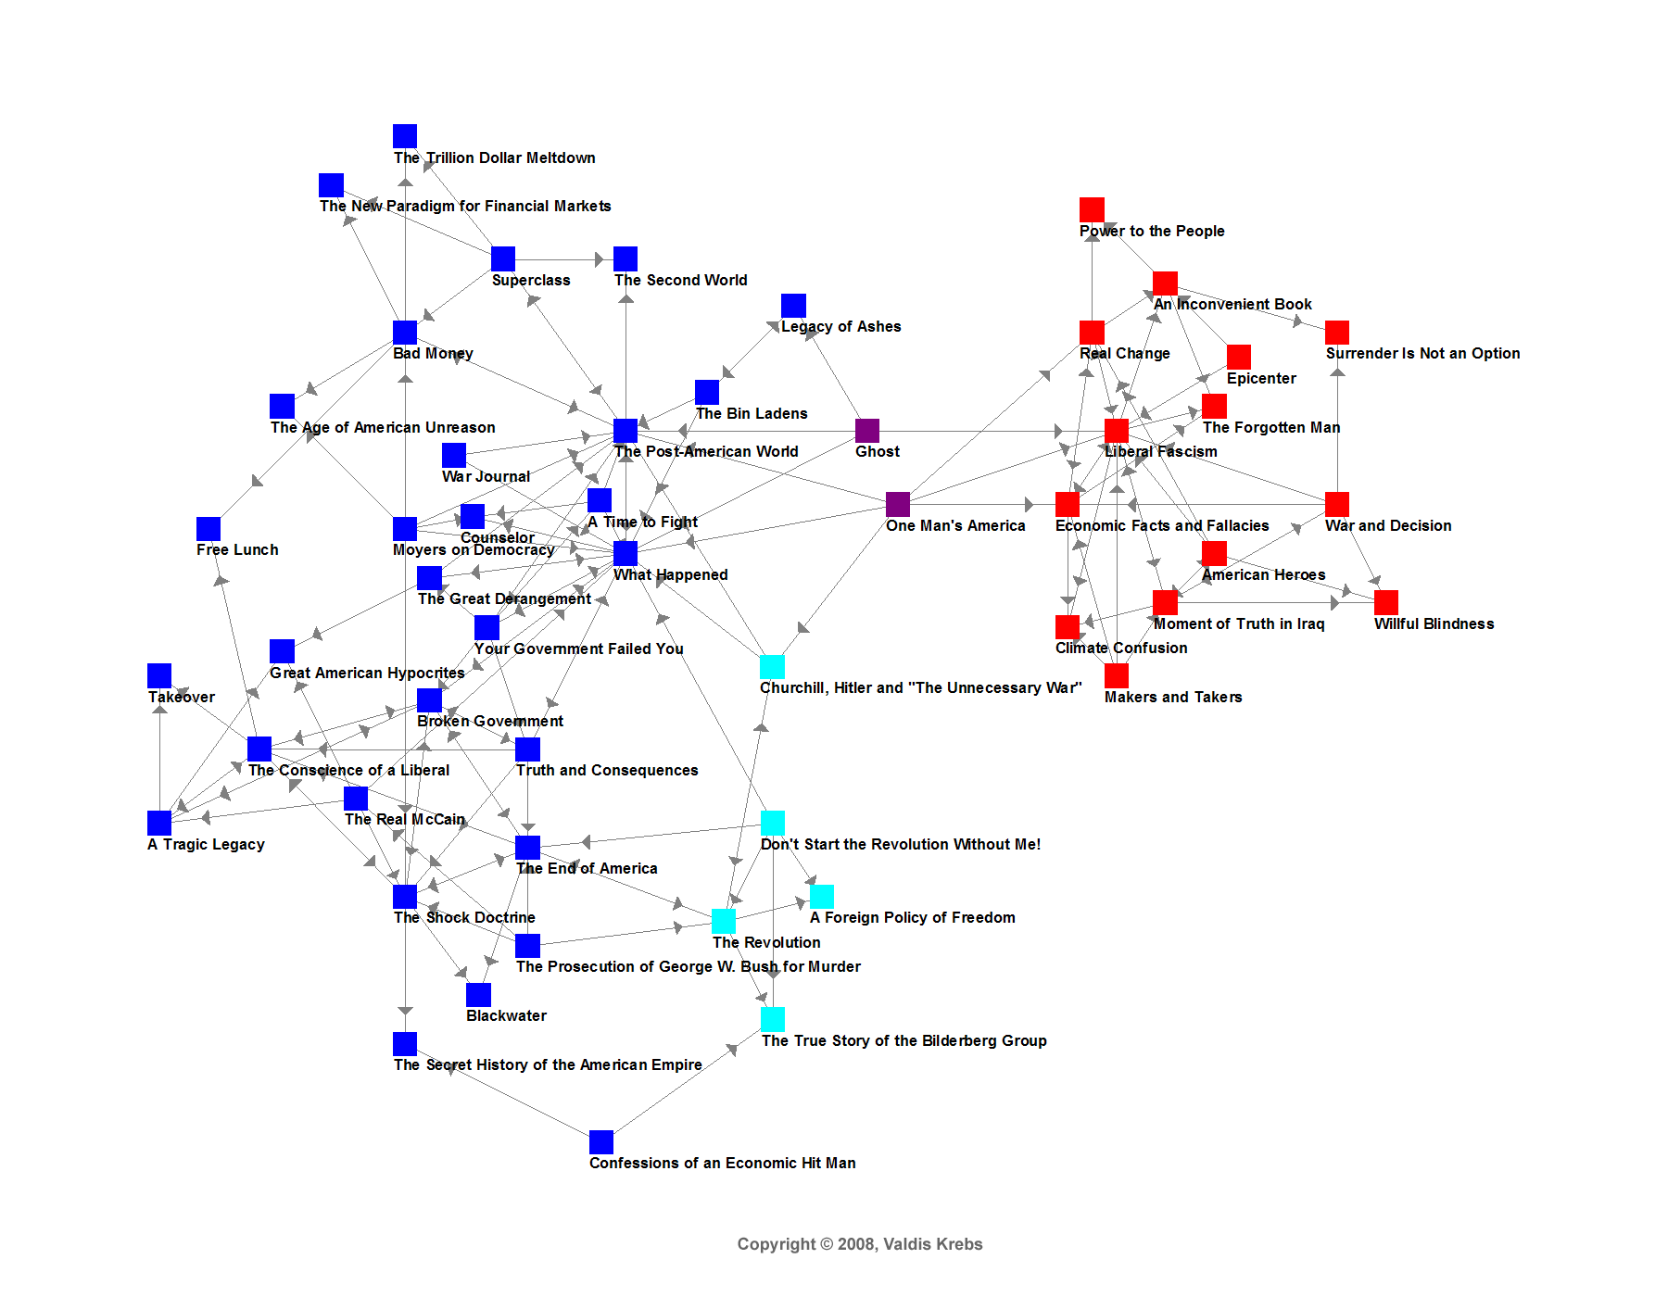
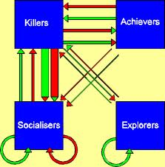
From a mix of viewpoints to a filter bubble

Slide 84
What used to be the virtual world…
Formal group identity
Points and quantified identity
Publicly visible profiles
Formal roles
Malleability of environment
Strong ties
Placeness
✓ Facebook does it better
✓ Facebook does it better
✓ Facebook does it better
✓ Facebook does it better
✓ Facebook does it better
Facebook does it better
Tedious, cut.

Slide 85
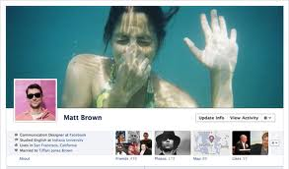
“Someday there won't be any admins. Someday it's gonna be your bank records and your grocery shopping and your credit report and yes, your virtual homepage with data that exists nowhere else. Someday it's gonna be Snow Crash and Neuromancer and Otherland all wrapped up into one, and it may be a little harder to write to Customer Service. Your avatar profile might be your credit record and your resume and your academic transcript, as well as your XP earned.
“On the day that happens, I bet we'll all wish we had a few more rights in the face of a very large, distributed server, anarchic, virtual world where it might be very very hard to move to a different service provider.
“So yeah. I'm not seriously proposing that we declare the rights of avatars. The doc is, as has been shown, riddled with gotchas and logical holes. It's a hypothetical exercise.
“For now.”
-Declaration of the Rights of Players, August 27th, 2000

Slide 86
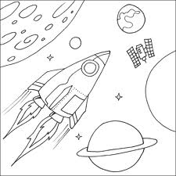
Once upon a time… In a galaxy far, far, away

Slide 87
THE WORLD VIRTUAL, or how we got our robot overlords.
I mean, protectors.

Slide 88
First, reputation
An oversimplified globalized single reputation value aggregator, like Rotten Tomatoes.
Followed by a rep farming or maintenance exploit firm designed to falsify reputations.
Followed by another that was a trust verification or exploit detection firm.

Slide 89
Our new selves
A classless system whereby world virtual userplayers could acquire levels in a range of skills.
Levels in your top few classes were the single most prominently visible thing on your profiles on Facebook.
A combination of these revolutionized the hiring industry and the dating industry.

Slide 90
LFG ASL STRDEXCON?
This led to a meatspace LFG system.
Adding in a few extra things like detailed analysis of physical and mental stats gathered via quantified self logging; geolocation; social network analysis to determine degrees of proximity; and cluster analysis of consumption patterns, typical communications and status update semantic content, etc, allowed the algorithms to quickly build up userplayer compatibility data, with a genetic algorithm no less, which would allow these LFG groups to largely automate the process of building kickass teams or highly compatible marriages.

Slide 91
Powerlevel!
Needless to say, these led to meatspace powerlevelling services, ways of trading money for higher level rankings in skills.
They were of dubious long-term value as they distorted the metrics around the LFG systems and undermined the core of the levelling system.

Slide 92
Social upheaval!
Organizations sprang up to wean people off of their addiction to gaining more and more levels, or to force them to take vacations or learn to play the social game “the right way.”
After all, society needs good retention, and reaching max level too quickly means you are more likely to opt out.

Slide 93
Society falling…
We heard of teams and marriages being broken up because one person outlevelled the others.
There was a booming business in walkthroughs for industries, though some businesses decried these as cheating.
Smart ones instead supplied cheat codes for career advancement.

Slide 94
The workplace
Jobs stratified, as in “I work in a level 10-20 company” (that says it fills a particular economic niche).
Many of these exist just to do repetitive activities that really don’t add huge economic value to anyone, but do result in the employees grinding up their skills.

Slide 95
Economic collapse
But the whole economy changed anyway, because ever since that first dupe bug of world virtual credits, the whole thing has been a little weird.
Sure, all the world’s currencies fell away in favor of a privately managed currency with perfect tracking where every single credit is tracked through the world economy perfectly, but nobody foresaw the stacking bug.
Plus the fact that the holding company gave away state currency as an incentive to join the system means that now there’s a rash of false userplayer profile creation in order to farm the newbie bonus.

Slide 96
I am multitudes
Not that the need for alts is ignored. Subcultures emerge wherein you can create a completely separate identity profile with its own alternate levels and identity; these start out as competitors to the principal identity system, but quickly turn into leeches instead, leveraging false profiles on the main identity system.
These are sometimes used just for entering specific subcultures (the closeted identity versus the public school board member identity) but eventually also get used for muling, and thereby tax evasion.

Slide 97
Cheaters!
Which results in a whole new class of admins whose job it is to find instances of simultaneous play of alts, because multiplaying the meatspace world is a huge source of bugs.

Slide 98
It’s all good…
The whole system relies on a unique namespace for individual ID’s.
There was a moment of panic when the admins first realized that they were running out of bits, then another one when they implement ID reuse and get clones, then another one when people start getting free levels and rep and money because they find that id reuse did not adequately clean up all the joined tables from the deceased.

Slide 99
True permadeath
Unfortunately, when a hacker managed to get a bunch of celebrities and politicians banned from the identity system, we discovered what happens when someone has their entire publc identity erased.
It wasn’t be too hard for the President to reroll (except that he had to get a new Social Security number — the admins really don’t do reimbs, sorry).

Slide 100
I’m not human, myself.
Needless to say, the President was actually a corporation embodied by a synthetic idoru-style entity, because from very early on in the development of all this, it was pointed out that legal entities can have reputations, levels, skills, compatibilities, personalities, and so on.
At the root level, there’s no distinction between a meatspace userplayer made out of meat and a meatspace userplayer who is actually fully virtual and using a meatspace identity as a sort of avatar into meatspace.

Slide 101
I’m actually dish soap.
In fact, there’s a booming business in what we might term the child industry of brand management, which does nothing but create and sell meatspace avatar identities for virtual beings such as corporations, lobbying organizations, movies, and new brands of detergent, enabling the detergent to pick up classes, levels, blood types, social security numbers, retirement accounts, a boyfriend, and a dog.

Slide 102
Modern life is so hard…
The detergent belongs to the household goods guild, needless to say, which has its own identity, which can be kind of confusing when the constituent members of the guild have personalities and voices and argue with the guild (not the guild leader, but the guild), and let’s not even talk about how we can’t get the dishwater serviced ever since it got kicked out of the guild and lost guild bank privileges.

Slide 103
Whew.
Fortunately, all this already happened.
None of it is REALLY new.
Diploma mills?
Fake IDs?
Tax evasion?
Credit default swaps?
Brand management?
American Home Shield?
We’ve been playing games with society for thousands of years!

Slide 104
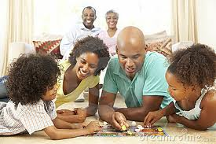
Games ARE social media.

Slide 105
Once Upon A Time…
And so the wizards started to forge the magic circle anew. A new kind of magic circle.

Slide 106
“I hope, that in our archives and historical filings of the future, we do not allow the techie traditions of hierarchy and false regularity to be superimposed to the teeming, fantastic disorderliness of human life.”
– Ted Nelson

